Slide 1
Medical Marijuana in the Connecticut Workplace
Presented to:
Human Resources Leadership Association of Eastern Connecticut
April 10, 2018

Slide 2
Presented By
Patricia Reilly
Partner
203-772-7733
preilly@murthalaw.com

Slide 3
29 States Plus the District of Columbia Permit the Use of Medical Marijuana
Alabama
Alaska
Arizona
Arkansas
California
Connecticut
Delaware
District of Columbia
Florida
Hawaii
Illinois
Maine
Maryland
Massachusetts
Michigan
Minnesota
Montana
Nevada
New Hampshire
New Jersey
New Mexico
New York
North Dakota
Ohio
Oregon
Pennsylvania
Rhode Island
Vermont
Washington
West Virginia

Slide 4
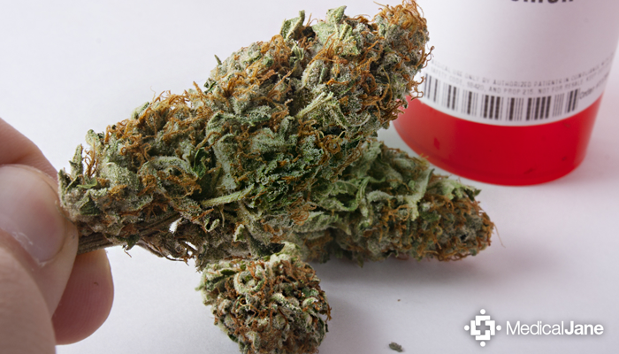
Connecticut Employer Defined
Conn. Gen. Statute Sec. 21a-408p: For the purposes of this section:
- “Employer” means a person engaged in business who has one or more employees, including the state and any political subdivision of the state.

Slide 5
Compare Definition of Employer Under CT Fair Employment Practices Act
Employer includes the state and all political subdivisions thereof and means any person or employer with three or more persons in such person’s or employer’s employ.

Slide 6
Anti-Discrimination Provision
(b) Unless required by federal law or required to obtain federal funding:
(3) No employer may refuse to hire a person or may discharge, penalize or threaten an employee solely on the basis of such person’s or employee’s status as a qualifying patient or primary caregiver under sections 21a-408 to 21a-408n, inclusive.

Slide 7
Connecticut Drug-Free Workplace Policies Allowed
Nothing in this subdivision shall restrict an employer’s ability to prohibit the use of intoxicating substances during work hours or restrict an employer’s ability to discipline an employee for being under the influence of intoxicating substances during work hours.

Slide 8
Marijuana in the Workplace Not Protected
Protections do not apply to:
The ingestion of marijuana (A) in a motor bus or a school bus or in any other moving vehicle, (B) in the workplace, (C) on any school grounds or any public or private school, dormitory, college or university property, (D) in any public place, or (E) in the presence of a person under the age of eighteen.
“Presence” means within the direct line of sight of the palliative use of marijuana or exposure to second-hand marijuana smoke, or both.

Slide 9
Covered Conditions
For Adults, Debilitating Medical Conditions Include:
Cancer
Glaucoma
Positive Status for Human Immunodeficiency Virus or Acquired Immune Deficiency Syndrome
Parkinson’s Disease
Multiple Sclerosis
Damage to the Nervous Tissue of the Spinal Cord with Objective Neurological Indication of Intractable Spasticity

Slide 10
Covered Conditions
Epilepsy
Cachexia
Wasting Syndrome
Crohn’s Disease
Post-Traumatic Stress Disorder
Sickle Cell Disease
Post Laminectomy Syndrome with Chronic Radiculopathy
Severe Psoriasis and Psoriatic Arthritis
Amyotrophic Lateral Sclerosis
Ulcerative Colitis
Complex Regional Pain Syndrome
Cerebral Palsy
Cystic Fibrosis
Irreversible Spinal Cord Injury with Objective Neurological Indication of Intractable Spasticity
Terminal Illness Requiring End-Of-Life Care
Uncontrolled Intractable Seizure Disorder
Note: There is a process for adding conditions.
Thus, this list is evolving.

Slide 11
Logistics
Administered by Department of Consumer Protection
Department of Consumer Protection website contains all registration information

Slide 12
Employer Legal Issues With Medical Marijuana
Private Right of Action under Conn. Gen. Stat. § 21a-408p(b)(3)
See Noffsinger v. SSC Niantic Operating Company LLC, d/b/a Bride Brook Nursing & Rehabilitation Center, No. 3:16-cv-01938 (JAM) (August 8, 2017)
No Federal Pre-Emption

Slide 13
Employer Legal Issues Continued
Americans with Disabilities Act and corresponding state laws
Family and Medical Leave Act
Duty to provide a safe workplace
Tension between state and federal law

Slide 14
State Accommodation Laws
The Connecticut Commission on Human Rights and Opportunities is requiring employers to accommodate disabled individuals using medical marijuana in Connecticut

Slide 15
ADA
Individuals “currently engaging in the illegal use of drugs” – including Schedule I marijuana – are not protected under the ADA
Exception: “Illegal use of drugs” does not include the use of a Schedule I drug taken under supervision by a licensed health care professional
Employers may adopt reasonable policies/procedures to ensure that employees are not engaging in the “illegal use of drugs”

Slide 16
ADA
Former/recovering addicts must be accommodated under the ADA; these individuals must be engaged in the interactive process
Drug addicts may suffer from a disability under the ADA, provided that they are not currently using drugs/marijuana

Slide 17
ADA
Must also accommodate employee with a disability who is a medical marijuana user
Engage in interactive process
Find out if there are medicines or therapies that might also alleviate symptoms
If there are, you may be able to require the employee to pursue those alternatives

Slide 18
ADA
There are risks with accommodating/not accommodating employees
Accommodating: impaired individuals may compromise safety; liability concerns to third parties; risk of dealing with law enforcement activity
Not Accommodating: discrimination lawsuits; bad press

Slide 19
FMLA
Treatment for substance abuse (including marijuana abuse) may be considered a “serious health condition” under the FMLA, provided that conditions for inpatient care and/or continuing treatment are met
Treatment for substance abuse does not prevent the employer from taking an adverse employment action against an employee

Slide 20
OSHA Duty to Provide Safe Workplace
OSHA – despite a “general duty” to provide a safe work environment, does not require or authorize drug testing

Slide 21
Drug Free Workplace Policies
Applies to federal contactors with $150,000+ contracts and federal grant money of any amount
Requires employer to publish a DFWP policy that prohibits, among other things, use or possession in the workplace
Require employers to report drug-related crimes occurring in the workplace
If employers do not comply, their contracts and/or grant money are at risk
ADA states that an employer may require employees to behave in a manner that meets federal Drug-Free Workplace Act requirements
The unlawful manufacture, distribution, dispensation, possession, or use of a controlled substance is prohibited in person’s workplace; and
The employee must abide by the terms of that statement

Slide 22
Drug Testing Policy Recommendations
Institute policy that requires employees to disclose use of medications that may impair their ability to work if this request is job-related and consistent with business necessity
If an employee tests positive for marijuana, confirm that employee is prescribed marijuana

Slide 23
Connecticut Drug Testing
Conn. Gen. Stat. § 31-51t - §31-51aa
Regulates urinalysis drug testing
No random urinalysis testing
Reasonable suspicion required
Random testing okay for designated safety sensitive positions

Slide 24
Questions

