Slide 1

Employee Engagement, HR Metrics & Analytics
Talent Strategist
Organizational Development Consultant
Leadership Development & Assessment
Executive Assessment & Coaching
Dr. Craig Haas
SHRM-SCP, SPHR, GPHR
www.CraigHaas.com
Notes:
1

Slide 2
Some Key Terms
- Employee Engagement
- Big Data
- HR Metrics
- HR Analytics

Slide 3
Employee Engagement
Our working definition…
Employee engagement is the emotional commitment the employee has to the organization and its goals

Slide 4

What is Big Data?
Notes:
4

Slide 5
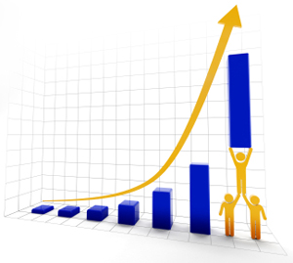
What are HR Metrics?
Notes:
5
HR Metrics is the name we apply to what we have probably been doing all along. Collecting data, producing reports, and monitoring HR activities.

Slide 6
Question
What Metrics do you track?
Notes:
6

Slide 7
Benefits of HR Metrics
Feedback is required for continuous learning
Accountability ‘What gets measured gets done’
Quantify the value of HR
Guide workforce strategies
Maximize HR’s return on investments
Show what HR contributes to business results
Make the business case for HR’s objectives
Notes:
7

Slide 8
Challenges with Metrics
“You can’t measure what we do…”
Lack of clear purpose for measuring
Lack of cooperation between departments
Difficulty extracting data from multiple systems
Difficulty understanding and analyzing metrics
Numbers used to draw inaccurate conclusions
Notes:
8

Slide 9
What Are Analytics
Analytics use statistics to identify relationships between data sets to help firms address problems and make talent decisions.
Most HR organizations have been slow to adopt analytics – too slow, in fact, in the minds of many impatient business leaders.
For example, while ~50% of companies are using Online Assessments…just 14% of HR organizations in the U.S are using predictive analytics to make talent decisions (Bersin by Deloitte’s study, 2013).
Notes:
9

Slide 10

What can HR Analytics help us to solve?
Staff Churn
Productivity
Sales Target
Achievement
All sorts of business problems that involve people…
But first you need to have the relevant data sources.

Slide 11
Employee Engagement
Research has shown it to be linked to important outcomes:
- Discretionary effort
- Job performance
- Employee retention
- Innovation
- Adapting to change
- Revenue & profitability
- Customer experience
Employee Engagement data shows you a snap shot in time about the current state of Workforce Engagement.

Slide 12

Where Shall We Focus?
Notes:
12

Slide 13
Predictive Analytics Applied to
Employee Engagement Data & Big HR Data
Can help Your Internal clients’ solve critical problems and answer burning questions
It is not a complex as it seems,
but it requires a bit of statistics skills.
Notes:
13

Slide 14

Big Data Meets
Predictive Analytics
what happens when we look at a metric for one thousand candidates?
14
Notes:
14

Slide 15
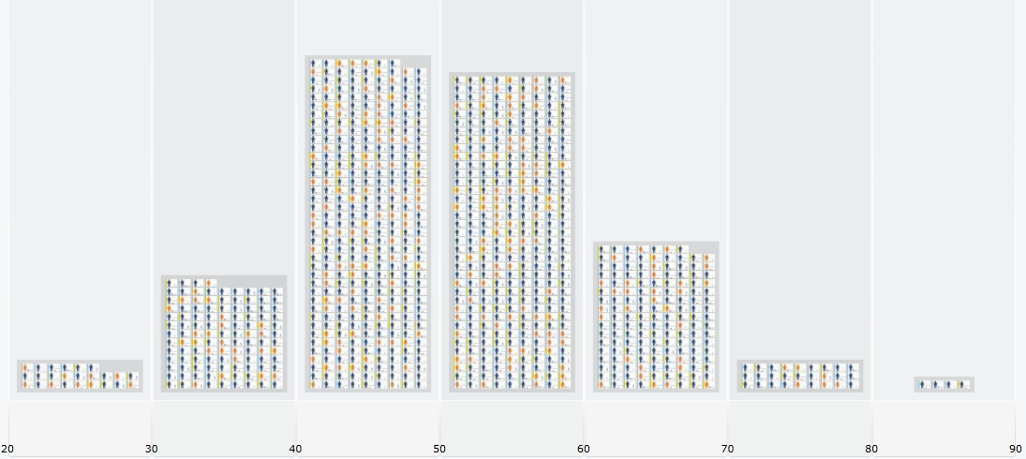
Predictive Analytics
15
15
Notes:
15

Slide 16
Bell Curve
Average
16
16
Notes:
16

Slide 17



Correlations (r)
10
9
r = + 0.44
n = 16,948
USA population
8
7
height
6
5
4
3
2
1
Correlations(r) from +1.0 to -1.0
0
0
1
2
3
4
5
6
7
8
9
10
weight
Notes:
17

Slide 18
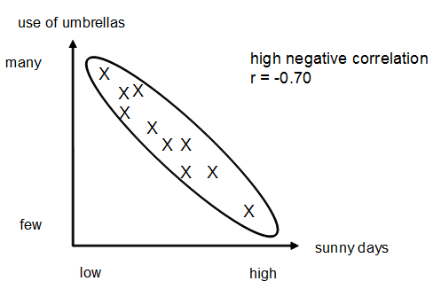
Negative Correlation
Example Use of Umbrellas
Correlations(r) from +1.0 to -1.0
Notes:
18

Slide 19
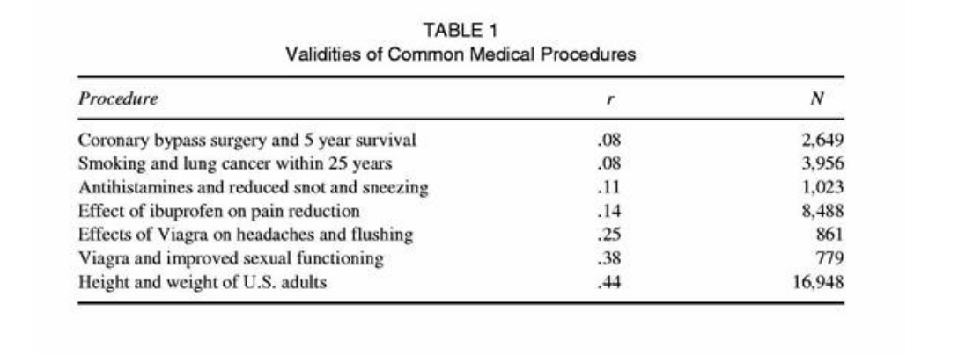
Correlations of common
medical procedures & outcomes

Slide 20
Regression Line (prediction)
10
9
8
7
height
6
5
4
3
2
1
0
0
1
2
3
4
5
6
7
8
9
10
weight
Notes:
20

Slide 21
Antecedents of
Employee Engagement
Talent Acquisition & Onboarding
- Person-Organizational Fit
- Person- Job Fit
- Setting realistic work expectations
- Fostering positive work relationships
Talent Development
- Training & career development opportunities
- Supervisor development & coaching oriented
- Feedback loops
Leadership
- Supervisor as a people leader (positive leadership traits)
- Psychological safety - work climate in which employees can thrive
- Employees empowered to make important decisions
Org Practices
- Perceived organizational support, justice and fairness
- Merit based recognition & rewards
- Flexibility in work-life arrangements

Slide 22
HR Analytics
Start Small…Baby Steps
Notes:
22

Slide 23
Analyzing Data
Microsoft Excel
Formulas
  Sum
  Average & Median
  Time Calculations
  Correlations
  Regressions
Notes:
23

Slide 24
Simple HR Analytics
with MS Excel
Notes:
24

Slide 25
Excel Tips
Select a Column or Row: Left click on very top of column (or far left end of row) and it will highlight the whole column (or row).
Average Formula: = average(A1, A2, A3)
Correlation Formula: =CORREL(array1, array2)
Note: an Array is any column (or a row) you select.
Formulas can be copied/pasted but you want to use ‘$’ to lock down certain columns.
Notes:
25

Slide 26
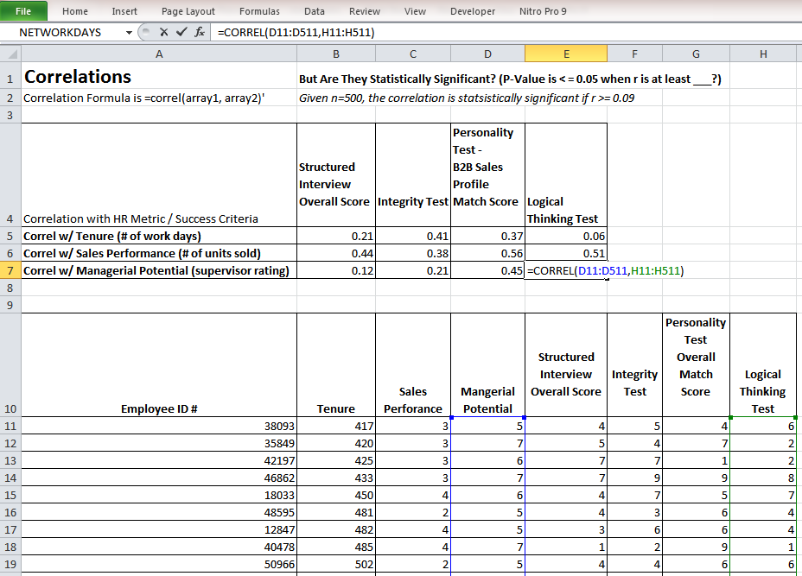
Excel Tips
Select a Column or Row: Left click on very top of column (or far left end of row) and it will highlight the whole column (or row).
Average Formula: = average(A1, A2, A3)
Correlation Formula: =CORREL(array1, array2)
Note: an Array is any column (or a row) you select.
Formulas can be copied/pasted but you want to use ‘$’ to lock down certain columns.
Notes:
26

Slide 27
Simple Reporting
Microsoft Excel (or equivalent)
Reports
  Tables
  Bar Graphs
  Pie Charts
  Scatter Plots
Warning:
Do not show your internal client a big
Excel file spread sheet with lots of data!
Notes:
27

Slide 28
Execs Like Dashboards !
If you can visually present in an intuitive way the impact that multiple variables have on a key outcome, you will more easily make your point to the Executive Leadership Team.
MS Office or equivalent are fine…..but there are also some really “Geeky Cool” Data Visualization tools available these days.
Notes:
28

Slide 29
Excel & PPT
Example of Using
MS Office for Dashboard:
A Business Case
on Selecting Salespeople

Slide 30
New Sales Goal Achievement
An Excel Bar Graph
Percentage of New Sales Target Achievement
High match score candidates achieved 98% of their sales target
Moderate match score candidates achieved 63% of their sales target
Low match score candidates only achieved 32% of their sales target

Slide 31
Closed Sales From Referrals
An Excel Pie Chart
# of New Sales from Salesperson’s Registered Referral Sources
High score candidates closed 63% of all the referrals sales
Moderate score candidates closed 32% of all the referral sales
Low score candidates only closed 5% of all the referral sales

Slide 32
Difference in Tenure
PPT Special Font for Emphasis
The average tenure for both
High and Moderate match score
candidates was at least
that of the Low match score candidates
Double

Slide 33
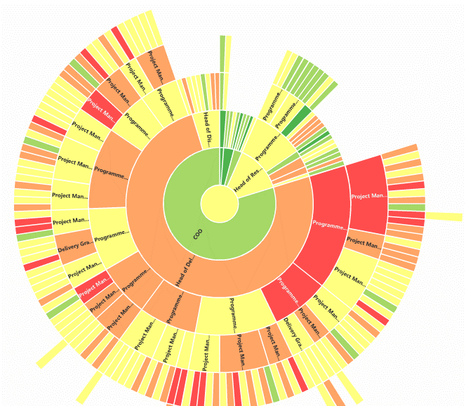
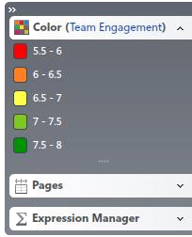
Dashboards w/ Cool Data Viz Software
Sunburst of Engagement Scores by Team Hierarchy
Source: OrgVue
Notes:
33

Slide 34
Get Started Now – Easy Steps
Find a leader with a problem
Persuade him/her to let you use analytics to help solve it
Figure out what metrics/outcomes may be relevant predictors & then collect the data
Create a combined score (regression formula) that predicts the desired outcome
Initiate the intervention based on what you have learned and measure change of performance over time
Notes:
34

Slide 35
HR Analytics Team Wanted
Find a business leader who is willing to partner on an analytics project to solve a problem (e.g. reducing turnover or accidents)
Create a project team (e.g. borrow talent from other departments, leverage the local Univ. or a supplier)
Get a small win and then promote its success
Repeat above process a few times to collect some small wins and build credibility with business leaders
Notes:
35

Slide 36
Once You’ve Proven It Works
Ask for resources to build an analytics team
Process must be owned by Executives, Managers, HR, Finance, and IT
Review org strategy, objectives and then discuss the leadership’s burning questions about talent?
Select a problem or question to address
Figure out what data be used to predict it
Notes:
36

Slide 37
Let’s Talk
Craig Haas, PhD
Talent Strategist, OD Consultant & Coach
Mobile: 305-773-3167
Direct: 401-484-8348
chaas@AdvantagePerformance.com
I love networking let’s meet for coffee,etc.
Connect to me on LinkedIn www.linkedin.com/in/craighaas
Twitter : @CraigDHaas
YouTube: http://bit.ly/2jtuM7f
Notes:
37

