Slide 1
2018 Employment Law Update
HRLA
October 2018
Holly L. Cini, Esq.
Jackson Lewis P.C.
www.jacksonlewis.com

Slide 2

Agenda
New legislation
Supreme Court Update
Recent Decisional Law
Agency Actions
Trending topics:
  Sexual Harassment
  Paid Medical Leave

Slide 3
Legislative developments
Trending issues in workplace law

Slide 4

New CT Laws
Pay Equity Legislation
  Public Act No. 18-8 takes effect on January 1, 2019
    Previously, Connecticut law provided that employers could not:
      Prohibit employees from disclosing or discussing the amount of their wages with one another, provided the information was disclosed voluntarily.
      Prohibit employees from inquiring about one another’s wages.
      Require employees to sign waiver or other documents denying them the right to engage in the above activities.
      Discharge, discipline, discriminate, retaliate against, or otherwise penalize any employee who inquires about the wages of another employee.
    Public Act No. 18-8 provides that, in addition to the above restrictions, employers will no longer be permitted to inquire about a prospective employee’s wage and salary history unless a prospective employee has voluntarily disclosed such information or the employer is specifically authorized to do so by federal or state law.
    Employers may continue to inquire about other elements of a prospective employee’s previous compensation structure.
      For example, employers may still inquire whether a prospective employee was paid salary, by the hour, or received commissions. However, the law prohibits an employer from inquiring about the amount of salary or wages, the formulas used in commission or bonus plans, and similar information that would reveal the value of the elements of the employee’s previous compensation.

Slide 5
New CT Laws
An Act Concerning Minimum Employee Wages for Providers of State-Administered Services for Persons with Intellectual Disabilities
  Special Act No. 18-5 (Effective 07/01/2018)
  Provides that the CT Dept. of Developmental Services may allocate funds to increase wages of certain employees providing services to individuals authorized to receive supports and services through DDS beginning on January 1, 2019.
An Act Concerning Employee Notification of Requests Made Under the Freedom of Information Act
  Public Act No. 18-93 (Effective 10/01/2018)
  Requires agencies that receive FOIA requests to notify employees whose personnel, medical, or other similar files are affected.
  Private employers, while not affected, should consider best practices when faced with legal process requesting employee personnel file information.

Slide 6
SUPREME COURT UPDATE
Trending issues in workplace law

Slide 7
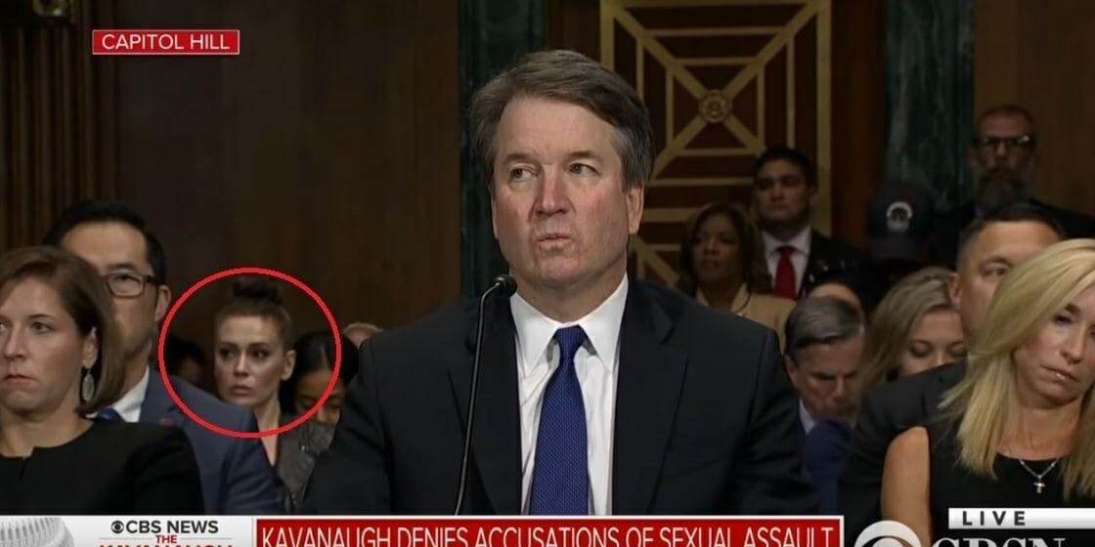

Slide 8
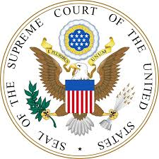
U.S. Supreme Court Update
  Agreements Requiring Individualized Arbitration Are Enforceable. The Supreme Court ruled (5-4) that the Federal Arbitration Act requires enforcement of arbitration agreements as-drafted—including when they require individualized proceedings. Class and collective actions are not “concerted activities” protected by §7 of the National Labor Relations Act, and the NLRA does not override the Arbitration Act (rejecting 2012 National Labor Relations Board opinion suggesting otherwise). Epic Sys. Corp. v. Lewis (May 2018).
  FLSA Exemptions No Longer Construed “Narrowly.” Supreme Court held that Fair Labor Standards Act gives no “textual indication” that its exemptions should be construed narrowly, and there is no reason to give them anything other than a fair, rather than narrow, interpretation. So-called “narrow construction” principle relies on flawed premise that the FLSA “pursues” a remedial purpose “at all costs.” But FLSA exemptions are as much a part of FLSA’s purpose as overtime-pay requirement. Encino Motorcars v. Navarro (Apr. 2018) (holding that automobile service advisers are exempt from overtime).
  SEC “Whistleblower” Must Actually Blow Whistle To SEC. In Digital Realty Trust v. Somers (Feb. 2018), the Supreme Court unanimously ruled that internal complaint of suspected securities laws violations did not entitle employee to anti-retaliation relief under Dodd-Frank Act. The Act defines “whistleblower” as individual who provides information to the SEC.

Slide 9

U.S. Supreme Court Update
Public Sector Unions Cannot Force Non-members To Pay “Agency Fee.” State and public sector unions may no longer extract “agency fees” from non-consenting employees. The First Amendment is violated when money is taken from nonconsenting employees of a public-sector union. In 5-4 decision, the Court overruled prior precedent Abood v. Detroit Bd. of Ed. (1977) as “poorly reasoned,” inconsistent with the First Amendment, and leading to practical problems and abuse. Janus v. AFSCME (June 2018).
Commission Failed To Show Religious Neutrality. Colorado Civil Rights Commission failed to review baker’s objection to creating wedding cake for gay couple with religious neutrality required by the First Amendment. The Commission’s public hearings evidenced open hostility to the baker’s religious beliefs. Supreme Court did not reach merits of baker’s refusal to create wedding cake for the couple. Masterpiece Cake Shop, Ltd. v. Colo. Civil Rights Comm. (June 2018).

Slide 10

U.S. Supreme Court
Court refuses to consider whether extended leave can be a reasonable accommodation under ADA. The Court rejected petition for cert. following Seventh Circuit decision holding that 2-3 month leave of absence, after employee already exhausted available FMLA time, was not a reasonable accommodation, characterizing the ADA as an “anti-discrimination” statute not a “leave entitlement” statute. Tenth and Eleventh Circuits have adopted similar positions on extended leave under the ADA. Severson v. Heartland Woodcraft, Inc.

Slide 11
Lessons from caselaw
Trending issues in workplace law

Slide 12

Second Circuit Update
Carigan v. Breitling USA, 2d Cir. (Sept. 10, 2018)
  Second Circuit revived 2015 Title VII sexual orientation discrimination claim. District Court should have the opportunity to determine if Plaintiff’s claims can survive summary judgment under new Second Circuit landscape prohibiting sexual orientation as discrimination “because of sex” under Title VII.
Noffsinger v. SSC Niantic Operating Co., D. Conn. (Sept. 5, 2018)
  The United States District Court for the District of Connecticut (Meyer, J.) granted summary judgment in favor of a job applicant who disclosed that he was an authorized medical marijuana user and subsequently was not hired because they tested positive on the company’s pre-employment drug test. The Court also found that Connecticut’s Palliative Use of Marijuana Act does not permit successful plaintiffs to collect attorney’s fees or punitive damages.

Slide 13

Connecticut Case Law
Horvath v. City of Hartford, 178 Conn. App. 504 (2017)
  Connecticut Appellate Court agreed that the accumulation of adverse conditions in the workplace can amount to intolerable conditions for assessing whether a constructive discharge occurred.
Grose v. Didi, LLC d/b/a Ashley Furniture Store, 2018 Conn. Super. LEXIS 790 (Apr. 11, 2018)
  Continued employment was sufficient consideration for arbitration agreement signed by employee 1.5 years after employment commenced
    Continued employment was sufficient consideration where employer indicated employees would be terminated if they refused to sign agreement.
    Mutuality of obligation to arbitrate also valid consideration for agreement.

Slide 14
Agency Actions
Trending issues in workplace law

Slide 15
Agency Action - EEOC
The Equal Employment Opportunity Commission released its preliminary data regarding workplace harassment on October 4, 2018. And it’s findings shouldn’t be a surprise . . . .
Charges filed with the EEOC alleging sexual harassment increased by more than 12 percent from FY 2017.
The EEOC recovered nearly $70M for victims of sexual harassment through administrative enforcement and litigation, up from $47.5M in FY2017.
Reasonable cause findings in harassment claims increased to nearly 1200, up from 900 in FY 2017.
And public interest is skyrocketing: The EEOC’s website traffic to its sexual harassment page more than doubled in the last year.

Slide 16
Agency Action - CHRO
In Connecticut, the Commission on Human Rights and Opportunities has not yet released their statistics – that typically happens each year in the fall
The CHRO is celebrating its 75th anniversary with a whole host of programs including one on Overcoming Barriers in Employment and a #MeToo and LGBT Panel Discussion as well.

Slide 17

Agency Action
New Guidance from the Equal Employment Opportunity Commission
  The EEOC issued new informal guidance on Promising Practices for Preventing Harassment.
  What this means:
    Informal guidance has no formal legal effect, but provides guidance as to how the EEOC may view employer policies as they enforce legal requirements pertaining to harassment in the workplace under Title VII, the ADA, and the ADEA.
  The new informal guidance sets forth best practices for employers seeking to create and enforce policies and practices to prevent and correct harassment.

Slide 18
Agency Action
New EEOC Guidance (cont.)
  The emphasis of the new guidance is on five core principles that have been generally proven effective in preventing and addressing harassment:
    Committed and engaged leadership;
    Consisted and demonstrated accountability;
    Strong and comprehensive harassment policies;
    Trusted and accessible complaint procedures; and
    Regular, interactive training tailored to the audience and the organization.
  The guidance may be found at https://www.eeoc.gov/eeoc/publications/promising-practices.cfm

Slide 19
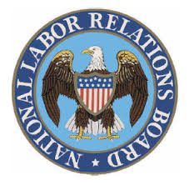
Agency Action
National Labor Relations Board set to re-examine joint employment test
  The NLRB released a proposed rule on the standard for determining joint-employer status—in 2nd attempt to overturn Obama-error expansion of joint-employer status
  Under proposal, entities will be considered “joint-employers” under the NLRA only if there is proof that one entity actually has exercised control over the essential employment terms of another entity’s employees (such as hiring, firing, discipline, supervision and direction)
  Under the proposed rule, proof of indirect control, contractually-reserved control that has never been exercised, or control that is “limited” and “routine” are not sufficient to establish joint-employer relationship

Slide 20
HOT TOPICS
Trending issues in workplace law

Slide 21

Sexual Harassment
The impacts of #MeToo are expected to continue to be felt
  In 2018, the Connecticut legislature considered, but did not ultimately pass, comprehensive revisions to Connecticut law as it pertains to issues of harassment.
  Legislation can be expected to be taken up again next year, which could entail any or all of the following:
    Changes to statutory filing periods for claims of discrimination and harassment.
    Changes to training requirements for employers, particularly smaller employers.
    Changes to the law with respect to the enforceability/permissibility of confidentiality provisions in employee agreements, particularly where they pertain to claims of harassment.

Slide 22

Paid Family and Medical Leave
Paid Family and Medical Leave
  Connecticut has been investigating the concept of establishing a program providing Connecticut employees with paid family and medical leave for years.
  The concept of any such program has, to date, focused on a payroll tax on all employee paychecks going into a fund administered by the State of Connecticut, which would disburse benefits to qualifying individuals when they take family and medical leave.

Slide 23
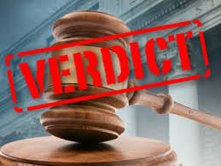
Jury Verdict Trends
Nationally, the highest awards from juries came when employers failed to follow their own policies and procedures
Hudson v. Beverly Fabrics, Inc.: Verdict of $2.6 million when employer failed to adequately investigate Plaintiff’s claim of same-sex sexual harassment. (Sup. Ct., Calif., March 2018).
Moland v. McWane, Inc.: Verdict of $16.6M ($13.8M punitive damages) when company terminated Plaintiff (the first African American supervisor at his facility) for “not getting along” with co-workers at conclusion of company’s internal investigation into his race discrimination claim, including complaints that supervisors and high-ranking management called Plaintiff the N-word behind his back. (Sup. Ct. Calif., July 2018)
Axel v. Fields Motorcars of Florida, Inc.: Verdict of $4.5 million when employer failed to follow its progressive discipline policy for terminally-ill Plaintiff, but did follow progressive discipline for similar conduct by non-terminally-ill employees. (M.D. Fla., May 29, 2017).

Slide 24
Questions?
Holly.Cini@jacksonlewis.com

Slide 25
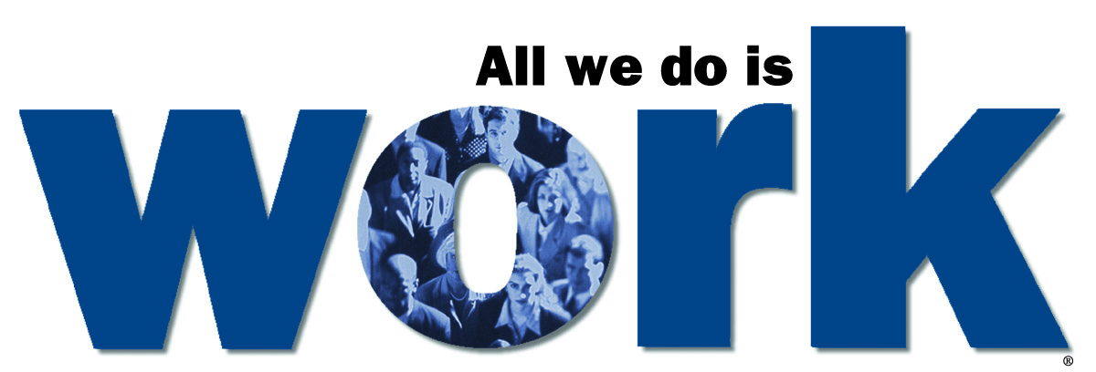
Thank You!
Workplace law. In four time zones and 59 major locations coast to coast.

