Slide 1
Making Heads and Tails of Service, Emotional Support and Therapy Dogs
Sara R. Simeonidis, Esq.
Jackson Lewis P.C.
www.jacksonlewis.com

Slide 2

Agenda
Understand the differences between service, emotional support, and therapy animals
ADA requirements for places of public accommodation
Accommodating animals in the workplace
Recent case law
Best practices

Slide 3
Why It’s IMPORTANT
Understanding the Differences Between Service, Emotional Support and Therapy Dogs

Slide 4

Why It’s Important
Estimated that 61.5M Americans (1 in 4 adults) experience mental health impairment
13.6M (1 in 17) live with serious mental illness
$193.2B lost earnings per year
2016 study estimates that 7% of employers allow dogs in workplace

Slide 5
guidance FROM AMERICANS WITH DISABILITIeS ACT
Understanding the Differences Between Service, Emotional Support and Therapy Dogs

Slide 6

Americans With Disabilities Act
Title I
  Prevents discrimination against disabled applicants and employees
  Applies to private employers
  Requires employers to provide reasonable accommodations
Title II
  Obligations for state and local governments
Title III
  Prohibits discrimination in places of public accommodation

Slide 7

Americans With Disabilities Act
Titles II and III
  Explicitly require that service animals be allowed to accompany individuals with disabilities in publically accessible areas
Title I
  Silent regarding service animals or emotional support animals as a form of accommodation

Slide 8
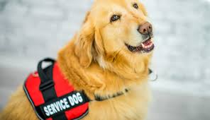
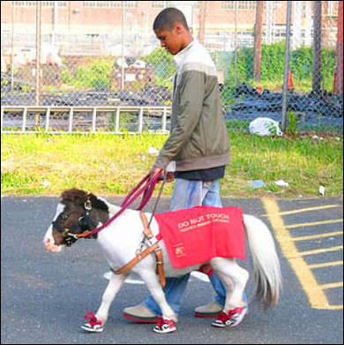
Service Animal Defined
  A service animal is a dog or miniature horse that performs a task directly related to an individual’s disability
  Examples include:
    directing blind person/alerting deaf person
    guiding/pulling wheelchair
    alerting to onset of seizure
    reminder to take medication
    calm PTSD/anxiety attack
  Under Title III (public accommodation) allowed to ask two questions
    Whether it is a service animal
    Whether it performs a task directly related to your disability
  May not require documentation such as proof that the service animal is certified, trained or licensed as a service animal

Slide 9

Emotional Support Animal
No precise definition under the ADA
Animal of any kind whose function is to provide support to its owner
  Not limited to dogs/miniature horses
  Not required to have any specific training
  Not required to perform a task specifically related to owner’s disability

Slide 10
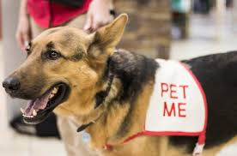

Therapy Dog
Trained to provide affection, comfort and love to individuals
Volunteer in settings such as hospitals, nursing homes, disaster areas, schools

Slide 11

Service vs. Emotional Support
Emotional support animals generally do not qualify as service animals under because they are not trained to perform a specific task related to owner’s disability
Places of public accommodation are not required to permit emotional support dogs on premises (unless required by state law—CT law does not require it)

Slide 12
OBLIGATIONS FOR EMPLOYERS
Understanding the Differences Between Service, Emotional Support and Therapy Dogs

Slide 13

What are Your Obligations?
Title I silent on service or emotional support animals
EEOC position—service and emotional support animals must be allowed as a reasonable accommodation
Employers cannot impose a blanket prohibition
Should treat as any other requested accommodation

Slide 14

To Accommodate or Not to Accommodate
Is the applicant/employee disabled
Is applicant/employee qualified under the ADA—i.e. able to perform the essential functions of the job with or without a reasonable accommodation
Would the requested accommodation allow employee to perform job duties
Would the requested accommodation create an undue hardship to employer and if so is there another reasonable accommodation that can be implemented

Slide 15

Interactive Process
Interactive process between employee and
employer may be necessary to determine an
appropriate reasonable accommodation
Goal is to identify the precise limitations from the disability and potential accommodations to overcome limitations
Both parties must participate in good faith interactive process
ADA does not require the accommodation of employee’s choice
Employer can choose between effective accommodations
Where disability and need for accommodation is not obvious—Employer may request reasonable medical information to demonstrate employee has disability and needs accommodation

Slide 16

Undue Hardship
Poses a direct threat, i.e. significant risk to health or safety of others
Disruptive
Not properly controlled by owner

Slide 17

Additional Considerations
Workplace could be dangerous for animals—for example manufacturing setting
Workplace may require sterile environment—for example a hospital
Other employees may be adversely affected—for example allergies, phobias
Impacts on insurance

Slide 18

Animals in Housing
Fair Housing Act prohibits discrimination
Landlord’s obligations:
  Can’t use “no pet” policy to deny housing to disabled person
  Must grant reasonable accommodation
2 threshold questions:
  Does person have a disability
  Is there a disability-related need for the animal—either service or emotional support
Unless:
  Animal would cause direct threat to health/safety to other
  Substantial physical damage to property of others

Slide 19
Lessons from case law
Understanding the Differences Between Service, Emotional Support and Therapy Dogs

Slide 20
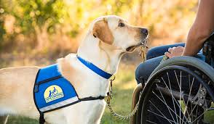
Lessons from Case Law
Branson v. West, 1999 U.S. Dist. LEXIS 7343 (N.D. Ill. 5/11/99)
  VA violated Rehabilitation Act
  Failed to allow paraplegic doctor to bring service dog to work to pull wheelchair
  Employer never argued that allowing dog would create undue hardship
  Court found as a matter of law that the service dog was a reasonable accommodation—granting summary judgment for doctor on failure to accommodate claim

Slide 21
Lessons from Case Law
Arndt v. Ford Motor Co., 247 F. Supp. 3d 832 (E.D. Mich. 2017)
  Employee with PTSD requested to bring service animal as accommodation
  Employee quit before interactive process completed
  Court noted that safety concerns with a dog in manufacturing area was a legitimate concern that Ford could consider

Slide 22

Lessons from Case Law
Edwards v. EPA, 456 F. Supp. 2d 72 (D. D.C. 2006)
  Employee had partial paralysis from stroke and Crohn’s disease
  Requested to bring 10 week old puppy to work to mitigate stress
  Employee felt he could do a “better” job with puppy
  Doctor’s note said the treatment was “experimental” and could not guarantee puppy would reduce flare-ups of Crohn’s disease
  “I would say ‘go for it!’ It certainly cannot hurt.”
  Employer denied request
  Court found no violation of Rehabilitation Act
  Employee did not establish a sufficient link between Crohn’s and puppy

Slide 23

Lessons from Case Law
EEOC v. Autozone, 2008 U.S. Dist. LEXIS 75350 (D. Ariz. 9/29/08)
  Employee was legally blind
  Worked for about 18 months and was physically able to perform most of his job duties. Job performance was good and supervisor said he “worked two times harder than anyone else”
  Requested LOA for service animal training school--granted
  Asked permission to bring service dog to work—needed dog to get to/from work
  HR commenced interactive process—requested information from doctor and training certificate
  Employee eventually terminated for failure to return to work
  Dispute regarding whether HR ever got training certificate, but never followed up with employee even after employee inquired about status
  Issues of fact precluded summary judgment

Slide 24
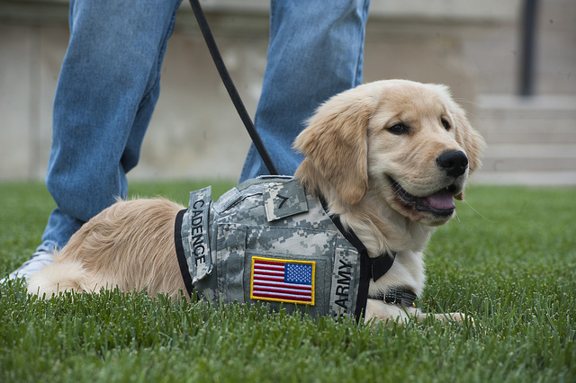
Lessons from Case Law
Alonzo-Miranda v. Schlumberger Tech. Corp., 2014 U.S. Dist. LEXIS 191082 (W.D. Tex. 11/24/14)
  Employee was Iraq war veteran suffering from PTSD
  Court found that allowing service dog was a reasonable accommodation
  Employer was within its rights to request medical information supporting employee’s condition and need for service dog
  Summary judgment denied—factual issue regarding good faith, interactive process and who contributed to delays

Slide 25
Lessons from Case Law
McDonald v. Dep’t of Envtl. Quality, 214 P3d 749 (Mont. 2009)
  Leg injury hindered employee ability to walk/navigate stairs
  Had dissociative identity disorder—episodes of inattentiveness/lost track of time/forgot interactions and events
  Service dog assisted with walking and trained to bring employee back from episodes
  Employer permitted dog to come to work
  Dog would slip in hallways and get injured which made dog less effective—asked employer to carpet hallways—employer denied request
  Employee brought suit alleging failure to accommodate
  Court likened service dog to any other assistive device
  “Duty to accommodate does not end in allowing the device through the door. Employer required to remove barriers to employee’s ability to actually use the device.”

Slide 26
Lessons from Case Law
Bonnette v. Shinseki, 907 F. Supp. 2d 54 (D. D.C. 2012)
  Blind employee requested to bring service animal to work
  Employer granted accommodation and implemented certain requirements to minimize contact with allergic co-worker
  Employee was required to use single-stall bathroom rather than ladies room and to use different entrance
  Employer also installed special $800 air filter to minimize allergens
  Court granted summary judgment to employer

Slide 27
Lessons from Case Law
Maubach v. City of Fairfax, 2018 U.S. Dist. LEXIS 73815 (E.D. Va. 4/30/18)
  Emergency dispatcher requested to bring emotional support dog for panic attacks
  HR agreed on trial basis
  Supervisor was allergic to dogs—returned from vacation to find clumps of dog hair and dander, dog beg left in dispatch center
  Another employee also complained about allergic reaction to dog
  Employee left dispatch center to walk dog—left untrained police officer
  Summary judgment for employer on failure to accommodate claim—dog not a reasonable accommodation under these circumstances
  Employee failed to engage in interactive process in good faith and refused to consider other possible accommodations

Slide 28
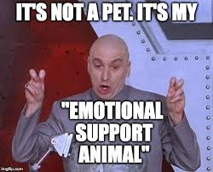
Lessons from Case Law
Clark v. School Dist. Five of Lexington & Richland Counties, 247 F. Supp. 3d 734 (D. S.C. 2017)
  Special needs teacher suffered from PTSD/panic disorder/agoraphobia
  Participated in pet therapy program with her special needs students
  Trained her Chihuahua Pearl as part of therapy program and eventually as a service dog for herself
  Brought Pearl to school for 2 years
  School program moved into a new building and dogs were banned
  Plaintiff requested to bring Pearl as a reasonable accommodation
  Court denied cross-motions for summary judgment—questions of fact if she could perform job without accommodation and if Pearl was only reasonable accommodation

Slide 29
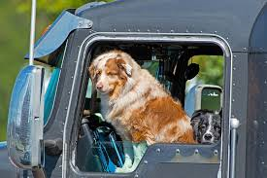
Lessons from Case Law
EEOC v. CRST Int’l, Inc., 2018 U.S. Dist. LEXIS 206948 (N.D. Iowa 12/7/18)
  Plaintiff applied for job as long-distance truck driver
  Received conditional offer and signed up for CDL training course
  Plaintiff then disclosed disability and requested to bring service dog in truck to help control anxiety and wake him from nightmares
  After successfully completing CDL training, Plaintiff claims he was denied employment because of “no pets” policy
  CRST then amended its policy after additional complaints by employees, but did not contact Plaintiff to engage in interactive process under its new policy
  Court denied cross-motions for summary judgment—question of fact whether Plaintiff could perform job with accommodation due to mental health

Slide 30


If Dog is Permitted in Workplace
Employee is responsible for dog’s care during work hours
Employee must control dog to avoid disrupting operations
Employee is responsible for dog’s hygiene and vaccinations

Slide 31

Best Practices
Understand that service and emotional support animals may be a reasonable accommodation
Treat request like you would any other request for accommodation
Consider whether allowing animal is reasonable/feasible
Consider whether any adjustments need to be made to accommodate the animal
Consider if adjustments need to be made for other employees in workplace

Slide 32
Questions? credits?
Sara.Simeonidis@jacksonlewis.com

Slide 33

Thank You!
Workplace law. In four time zones and 52 major locations coast to coast.

