Slide 1

HR Strategic Planning Workshop
Strategic Human Resource planning
involves a future-oriented, data-supported process
of identifying HR actions that address and solve
business problems and directly contribute to meeting
major long-term department and/or business objectives.

Slide 2
Learning Journey
1
2
3
Describe your HR department’s strategic capabilities through a S.W.O.T. Analysis
Identify and prioritize solutions and actions through a T.O.W.S. Analysis
Formulate a DRAFT Strategic Plan to help meet HR and/or Company goals

Slide 3
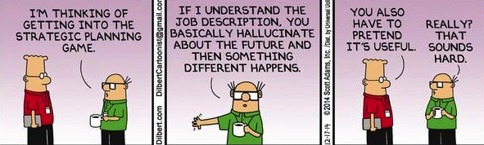

Slide 4
Agenda
Workshop “Job Description” with Leslie Bartholomew
Independent Work and Group Sharing with S.W.O.T.
Independent work on T.O.W.S.
Recap and Accountability Partnering
  (Reconnect at the Vineyard!)
Research opportunity with Bob Greene

Slide 5
Workshop Handout: S.W.O.T. Analysis Job Aid
Strengths (internal) When looking at your HR Department’s strengths, you’ll consider:
What does your data tell you about your HR dept?
  ( operational, financial, internal/external customers)
What does your department do better than others?
What do others in your company think are your strengths?
Anything else you think is a strength?
What competencies do you execute well?
  Leadership Navigation, Ethical Practice, Business Acumen, Relationship Management, Consultation, Critical Evaluation, Global Cultural Effectiveness, Communication, HR Expertise, Communication
Weaknesses (internal) When looking at your HR weaknesses, consider:
What could you improve?
What do outsiders see as your weaknesses?
What factors hold you back?
Anything else you consider as “going wrong” right now?
What competencies do you execute poorly?
  Leadership Navigation, Ethical Practice, Business Acumen, Relationship Management, Consultation, Critical Evaluation, Global Cultural Effectiveness, Communication, HR Expertise, Communication
Opportunities (external) When looking at potential opportunities for your HR department, consider:
What are the industry trends, new technologies and marketplace opportunities?
What options do your strengths open up for you?
Beneficial changes in the field/market?
Major changes, initiatives or programs being launched?
Threats (external) When looking at threats to my HR department, consider:
What obstacles do you face ie: workforce availability?
What threats do your weaknesses open you up to?
Stricter or limiting changes in the field/market?
HANDOUT

Slide 6




Workshop SWOT Example: Strategic Capability of HR Dept @ ABC
Strengths (internal)
Dedicated/LT Employees Feedback loops
Excellent Customer Service Led “safety culture”
Superior project mgmt Strong labor relations
High touch Empl Engagement
Weaknesses (internal)
Low energy/burnout Low imagination
Highly tactical/less strategic
Variable alignment ever-changing org priorities
Need for an OD role to help with structure improvements
Opportunities (external)
Marketing to new hires Partnerships
An engaging onboarding process for new hires
Leadership Development 2 New Initiatives
Career Pathing/Succession planning
Threats (external)
Competition for new hires
Constantly improving TECH in field/market
Generation Y expectations for high level positions
The need to customize “everything”
HANDOUT

Slide 7
Workshop Worksheet: S.W.O.T.: My HR’s Strategic capabilities
Strengths (internal)
Weaknesses (internal)
Opportunities (external)
Threats (external)

Slide 8
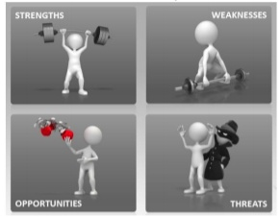
S.W.O.T.

Slide 9
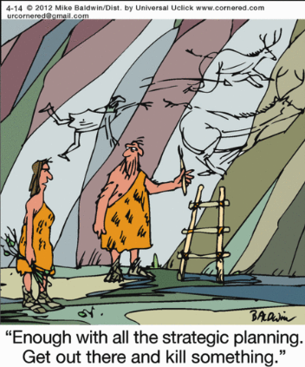

Slide 10
Time to Analyze with T.O.W.S.
 | Strengths | Weaknesses
Opportu- nities | SO - What Strength can help you leverage an opportunity? | WO - What Weakness can be minimized by taking advantage of an opportunity?
Threats | ST - What Strength can help you minimize or avoid a threat? | WT - What mitigating actions can minimize weaknesses and avoid a threat?
HANDOUT

Slide 11
T.O.WS. EXAMPLE
 | Strengths | Weaknesses
Opportu- nities | Dedicated LT Employees: Leadership Dev/2 new org initiatives. Let’s take the lead on these with Hi Po staff | Low Imagination:Transform Recruiting/Hiring Process via partnership with OD/PI team
Threats | Customization: Feedback Loops. Apply more loops to promote constant improvement based on user feedback | Need to create a plan for a “fast lane” development plan - as part of onboarding to retain and engage new employees
HANDOUT

Slide 12
WORKSHOP HANDOUT:
T.O.WS. of “my HR’s Strategic Capabilities”
 | Strengths | Weaknesses
Opportunities
Threats

Slide 13
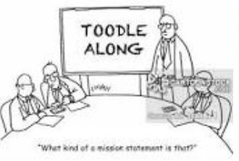
Why plan
when everything is going to change?
“What kind of strategic plan is this?”

Slide 14
HR Strategic Planning Workshop Recap
Strategic Human Resource planning
involves a future-oriented, data-supported process of identifying
HR actions that address and solve
business problems and directly contribute to meeting
major long-term department and/or business objectives.

Slide 15
HR Strategic Planning Workshop
What will be your next steps?
Accountability Partners...
Thank you!

